Slide 1
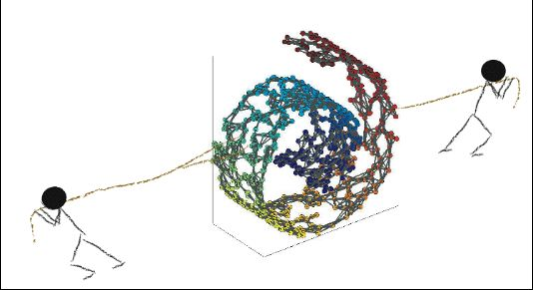
Manifold Learning

Slide 2
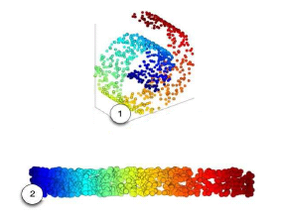
Manifold Learning

Slide 3
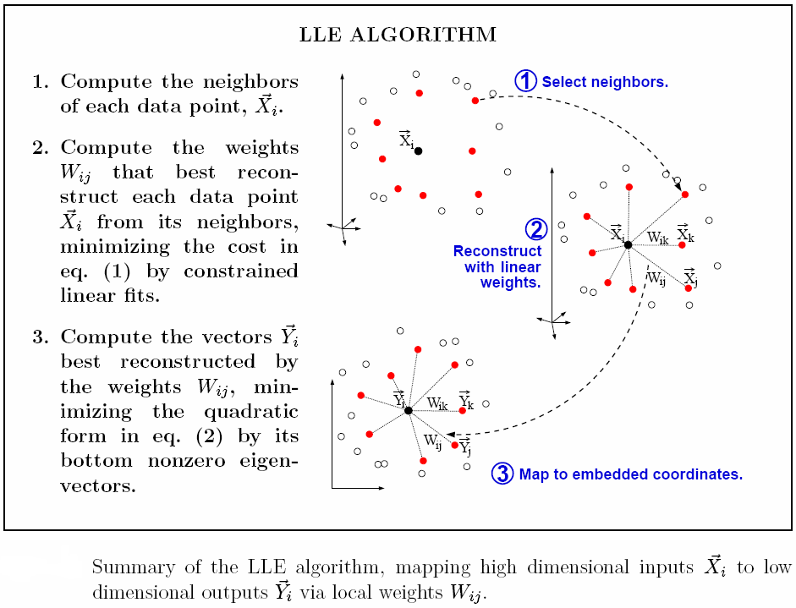

Locally Linear Embedding (LLE)

Slide 4


Slide 5


Slide 6


Slide 7


Slide 8
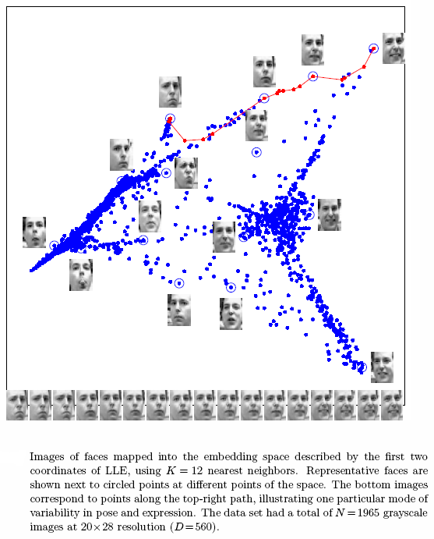

Slide 9
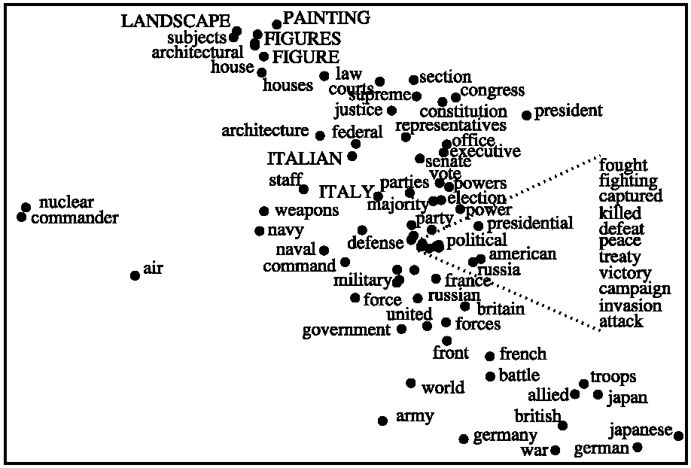
Arranging words: Each word was initially represented by a high-dimensional vector that counted the number of times it appeared in different encyclopedia articles. Words with similar contexts are collocated

Slide 10
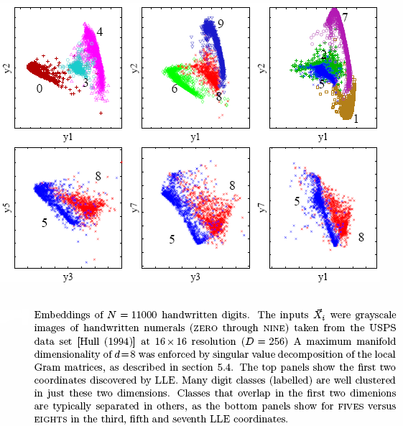

Slide 11
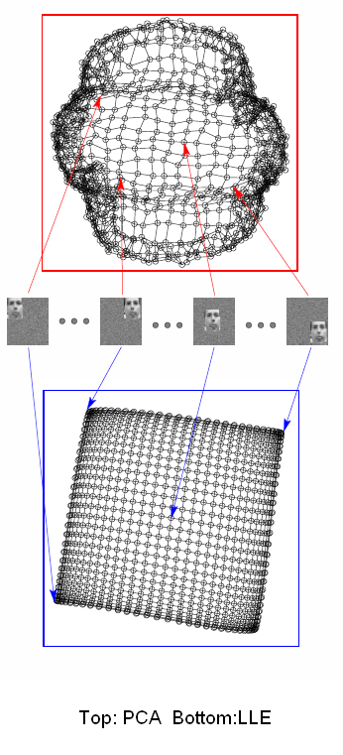

Slide 12
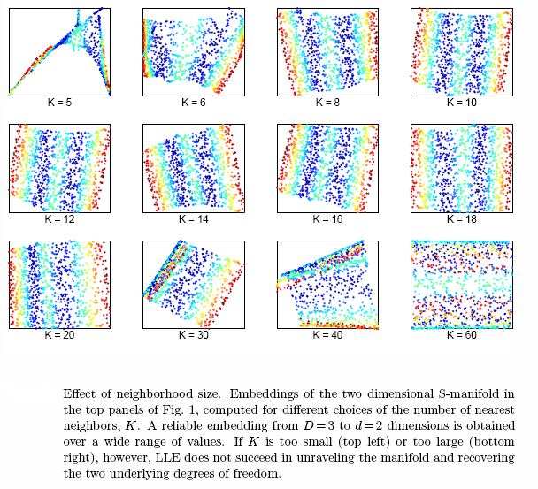

Slide 13
